Slide 1
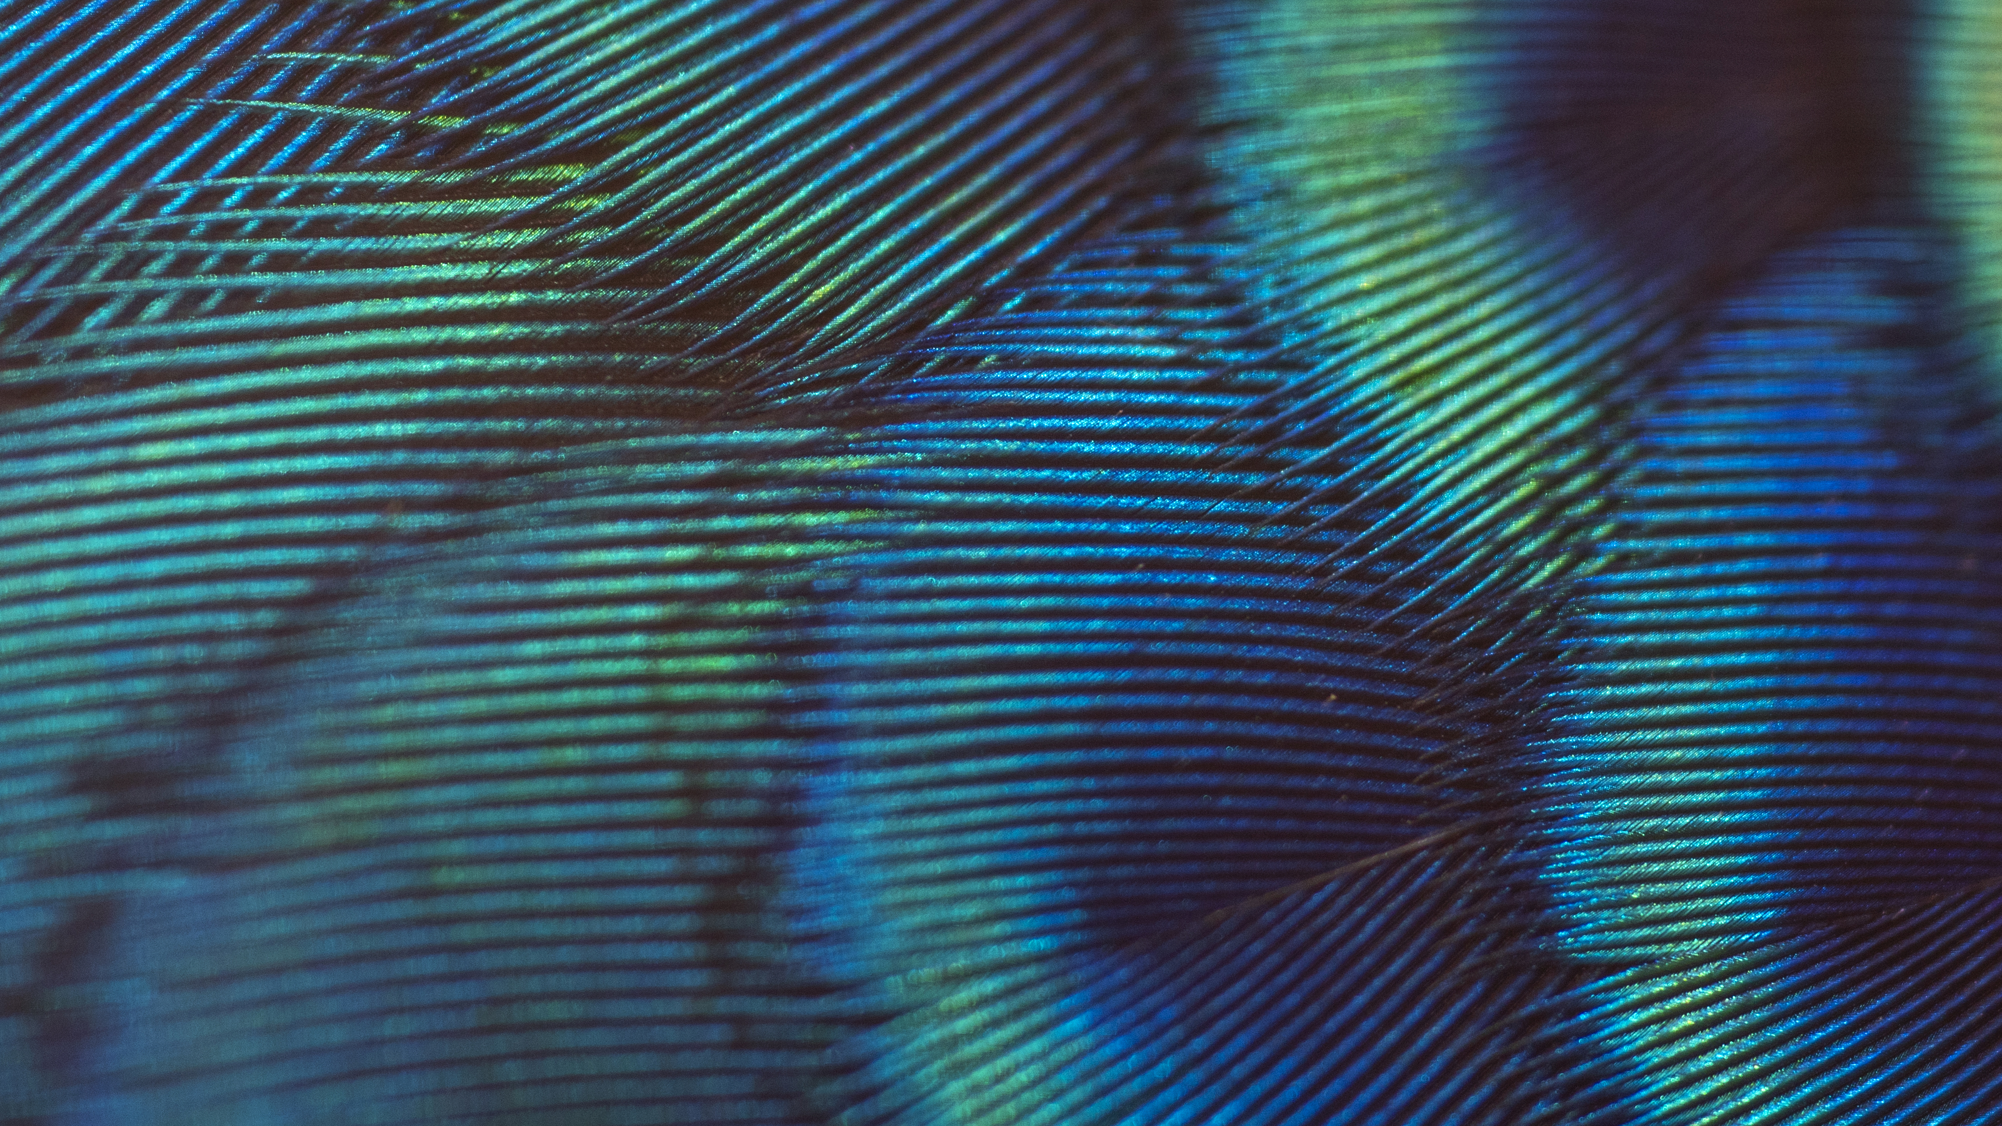
What is this thing called Privacy?
19th Int.l Summer School on Biometrics 2022
IDENTITY AND THE PRIVATE SPHERE
Emilio Mordini, M.D., M.Phil.
NORIA - Association for the Protection and Promotion of Culture as a Critical Infrastructure
Acknowledgments:
This presentation has been partly funded by the research project SOTERIA. SOTERIA has received funding from the European Union’s Horizon 2020 research and innovation programme under grant agreement No 101018342.
This content reflects only the author's view. The European Agency is not responsible for any use that may be made of the information it contains.

Slide 2
ETIMOLOGY SPEAKING
The word “privacy” derives from the Latin privatus, past participle of privo, “I deprive”, “I cut away”.
Privacy thus refers to the state of something that is separated, secluded from others. It refers to the state of being set apart, belonging to oneself, in contrast to the state of being public or common.

Slide 3
Bodypaint artist Jörg Düsterwald created the illusion with photographer Tschiponnique Skupin and a model called Nadine in a forest in Lower Saxony, Germany.

Slide 4
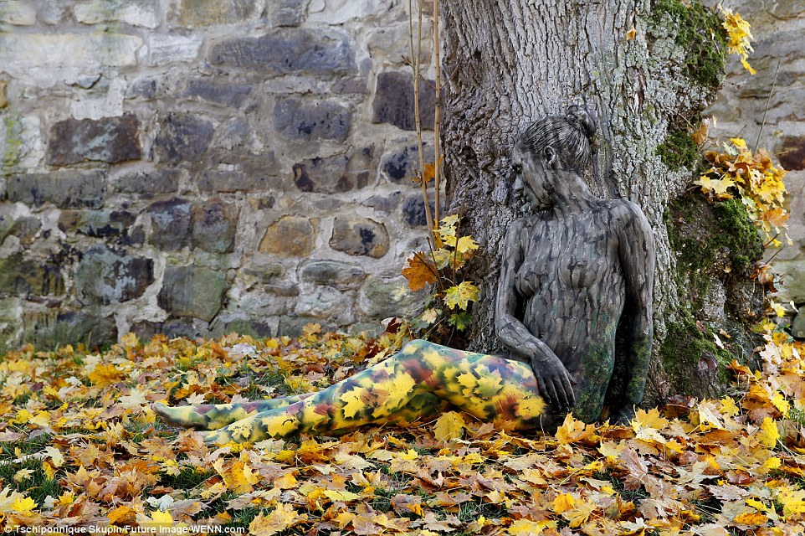
CAMOUFLAGE = BLENDED WITH THE SORROUNDINGS

Slide 5
L. BRANDEIS 1890
Notes:
One of the oldet

Slide 6
Privacy is the condition of not having undocumented personal information known or possessed by others (Parent, 1983)

Slide 7
Today PRIVACY is often confused with personal data protection

Slide 8
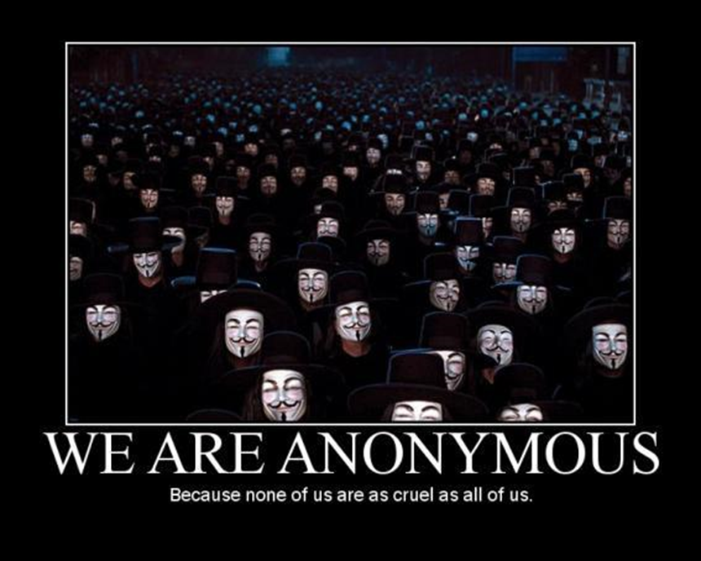

Slide 9
DATA PROTECTION
The ability of turning almost everything into measurable items, codifying them into digits, has been a key historical event, allowing information to be brought, stored, sold, and marketed. This event marks the Information Revolution as commodification of plants and animals, and commodification of labour, marked the agricultural and industrial revolutions.
The concept of “personal data protection” emerges from the Information Revolution as a consequence of the new economic value of data.

Slide 10
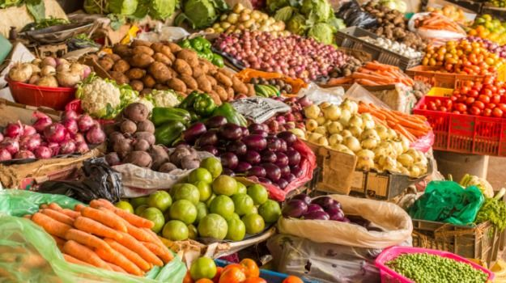
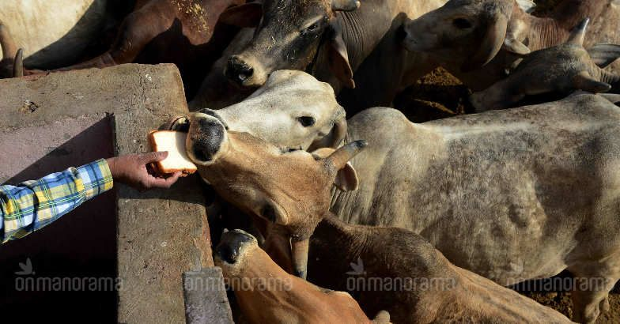
Wild Plants and Animals were domesticated and turned into commodities
AGRICULTURAL REVOLUTION

Slide 11
Human labor became measurable in terms of working hours and it was turned into a commodity
INDUSTRIAL REVOLUTION

Slide 12
Time is money Benjamin Franklin

Slide 13
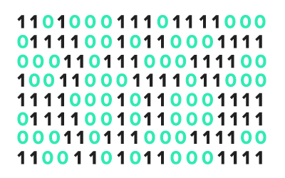
Information becomes measurable and it is turned into a commodity
INFORMATION REVOLUTION

Slide 14
Information is money

Slide 15
A FATAL CONFUSION
The confusion between privacy and personal data protection has contributed to generate a technical conception of privacy, framed in terms of risk management and technical ability to protect or to penetrate the (informational) private sphere. So, during the last few years most privacy issues have been turned into issues concerning various degree of data anonymity and ownership.

Slide 16
The main consequence is that privacy today is mostly dealt with by lawyers and legal depts.

Slide 17
NO

Slide 18
PERSONAL DATA IS ABOUT AN ECONOMIC ASSET PRIVACY IS ABOUT INVIDUALITY (IN-DIVISIBILITY)
THIS IS THE FIRST POINT I ASK YOU TO RETAIN FROM MY PRESENTION

Slide 19
Individual = Person

Slide 20
The word “person” comes form Latin “persona” which meant “mask”
Etimologically speaking the Latin persona meant “augmented voice”.
Masks worked as voice amplifiers and a way to make actors recognisable
Masks did not conceal actors rather they made manifest who they were providing them with a role and an identity on the stage,

Slide 21
Roman actors wore masks during the whole representation. Practically speaking, actors needed to make themselves recognizable in large amphitheaters, which might host more than 1,000 people, and to amplify their voices outdoor: masks could work well enough for both purposes.

Slide 22
Everything deep loves a mask (F. Nietzsche)
In origin, persona meant mask and theatrical character, only successively this term acquired also the meaning of person.
In classic antiquity, being “maskless” (e.g., slaves were defined as “maskless” people) was a negative condition. The mask was not a metaphor for insincerity rather it was considered a sign of the complexity and depth of human spirit.

Slide 23
Privacy is about masking, but masking is not about hiding, disguising, being anonymous; rather it is about BEING AN INDIVIDUAL PROVIDED WITH AN IDENTITY
THIS IS THE second POINT I ASK YOU TO RETAIN FROM MY PRESENTION

Slide 24
WHAT IS THEN PRIVACY?
Privacy is something which concerns our need to be individuals, the integrity of our identities in relation with other people and our social context.
Protecting privacy means to protect your bodily, mental, and social boundaries and consequently integrity.
Boundaries are essential both to get in relation and to keep distinct, they are between you and your surroundings

Slide 25
BODILY BOUNDARIES
As many mammalians and birds, human beings tend to segment the territory around them. In the inner circle there is an area that is perceived to be private, which is commonly called “personal space.” Most people feel discomfort when their personal space is violated, and personal spaces can be trespassed only in particular circumstances and only by selected others. This mechanism is rooted in neurophysiology, as it has been demonstrated by individuals who lack reactions to personal space violations and show lesions of a small cerebral region involved in emotional learning and memory modulation, the amygdale.

Slide 26
MENTAL BOUNDARIES
In early developmental stages infants hardly distinguish between themselves and the environment. States of wholeness, timelessness and oneness alternate with states in which the awareness of space, time, and separateness, slowly emerge. Through mother’s body, the infant starts exploring the world and perceiving a distinction between the inward and the outward. The inward is what is evident to the subject and can become evident to others only if it is communicated.

Slide 27
NOTHING TO HIDE, NOTHING TO FEAR ?
To become an individual, the child must develop a “internal” space and create boundaries between inner and outer world. The basic experience which allows infants to realize that they are individuals is when they perceive that their thoughts and feelings are not immediately perceptible by adults. This is an unpleasant experience because it originates from having their wants unmet, yet it also teaches infants something fundamental, that their fellows, even those who love them more, cannot read their thoughts, say, they have an identity distinct from anyone else identity.

Slide 28
We do not need privacy to hide anything, rather we need to hide something (no matter what) to create our private sphere, ultimately our identity
THIS IS THE THIRD POINT I ASK YOU TO RETAIN FROM MY PRESENTION

Slide 29
VALUE BOUNDARIES (DIGNITY)
Identity literally means sameness, A is identical to A (A=A) if, and only if, there only a unique A, say, we counted twice (A and A) what is actually one (A).
Personal identity means therefore that each person is unique. This feeling of uniqueness is what the experience of a private mental life generates throughout the normal development of a child .

Slide 30
DIGNITY
In ancient Rome, the word dignity (Dignitatis) indicated one's position in society, someone’s social rank and value
With the Renaissance, dignity has been increasingly used to indicate the rank and value of humans in relation to other natural items. These rank and value were supposed to be the highest because – as it went the argument – human beings were the most marvellous piece of nature
Finally, from the eighteenth century on, human dignity means that every human being is unique, priceless, Irreplaceable

Slide 31
DROPS OF WATER
We are like drops. We slowly emerge as individuals thanks to a bodily, mental, social tension between us and the world.
What we call “privacy” is anything but this surface tension which makes us to develop our identity

Slide 32
Privacy, Identity and Dignity are thus the three facets of a same prism. In order to protect one of them, you must protect them all.
This is also an important lesson to learn from a technological point of view
THIS IS MY FINAL POINT AND MY CONCLUSION

Slide 33
DENKEN IST DANKEN
I’m aware that I left more questions open than those I have answered, yet my goal was only to think together with you
A great German philosopher once told that thinking is thanking, we have thought together and now I must …

Slide 34
Thank you!
Emilio Mordini, M.D., M.Phil
CHAIR OF THE ETHICAL COMMITTEE OF THE EUROPEAN ASSOCIATION OF BIOMETRICS
NORIA, Scientific Director
Via Molino 45 – 33080 Fiume Veneto
Email: emilio.mordini@noria-onlus.it
Via Altan 47 – 33078 San Vito al Tagliamento (PN) – Italy
Email: em@emilio-mordini.it

